Slide 1



EchoDrop
A Prototype Multi-Platform Scheduled Messaging System
Presented By: Parth Dilipbhai Patel
Semester: 5th
Guided By: Mrs. Jyotsna Bhubanesh
Organization: R.K. DESAI ACHCHHARIWALA COLLEGE OF COMPUTER & APPLIED SCIENCES

Slide 2




Table of contents
01
02
Acknowledgement
Introduction & Objective
03
04
Tech Stack
System Architecture

Slide 3
Table of contents
05
06
Workflow
Key Features
(DFD Level 0 & 1)
07
08
Backend Deep Dive
Frontend Deep Dive

Slide 4
Table of contents
09
10
Database Schema
Screenshots - User Authentication
11
12
Screenshots - Scheduling & Management
Challenges & Solutions

Slide 5
Table of contents
13
14
Conclusion & Future Scope
References

Slide 6

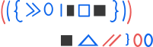




01
Acknowledgement

Slide 7





I express my sincere gratitude to
My project guide, Mrs. Jyotsna Bhubanesh, for her invaluable guidance.
The faculty for their unwavering support.
My friends for their encouragement.
My family for their constant motivation.

Slide 8


02
Introduction & Objective

Slide 9
What is EchoDrop?
A full-stack web application for scheduling messages across
Email, SMS, and WhatsApp.
Core Objective:
To build a robust, secure, and user-friendly platform that
allows users to plan their communication efficiently.
Problem Solved:
Eliminates the need to remember to send time-sensitive
messages manually.
Current Status:
Functional prototype demonstrating core functionality in a
controlled test environment.

Slide 10
Project Scope & Current Limitations
Authentication: Google OAuth configured for test users only
Messaging: Twilio trial account limits messages to verified numbers only
Deployment: Local development environment (not deployed to production)
Purpose: Functional prototype demonstrating core architecture and capabilities
These limitations are expected for a academic prototype and can be addressed with production resources and budget.

Slide 11



03
Tech Stack

Slide 12



Frontend
Backend
Services & APIs
Angular 17 (Standalone Components)
TypeScript, HTML, SCSS
RxJS, Bootstrap
Node.js, Express.js
Mongo DB with Mongoose ODM
Twilio API (SMS & WhatsApp)
Gmail API (OAuth 2.0 for Emails)
JWT for Authentication
Passport.js for Google OAuth

Slide 13


04
System Architecture

Slide 14


Angular Frontend
(User Interface)
(REST API / HTTP Calls)
Node.js + Express Server
(Application Logic)
MongoDB Atlas (Data Storage)
External APIs (Twilio, Gmail)

Slide 15
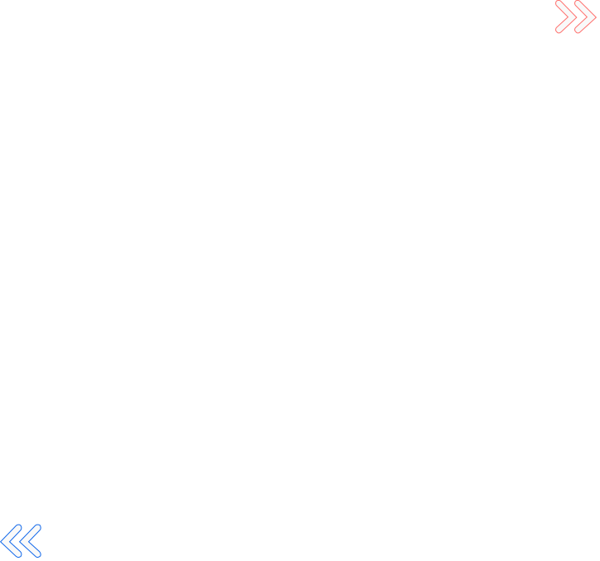

05
Workflow

Slide 16

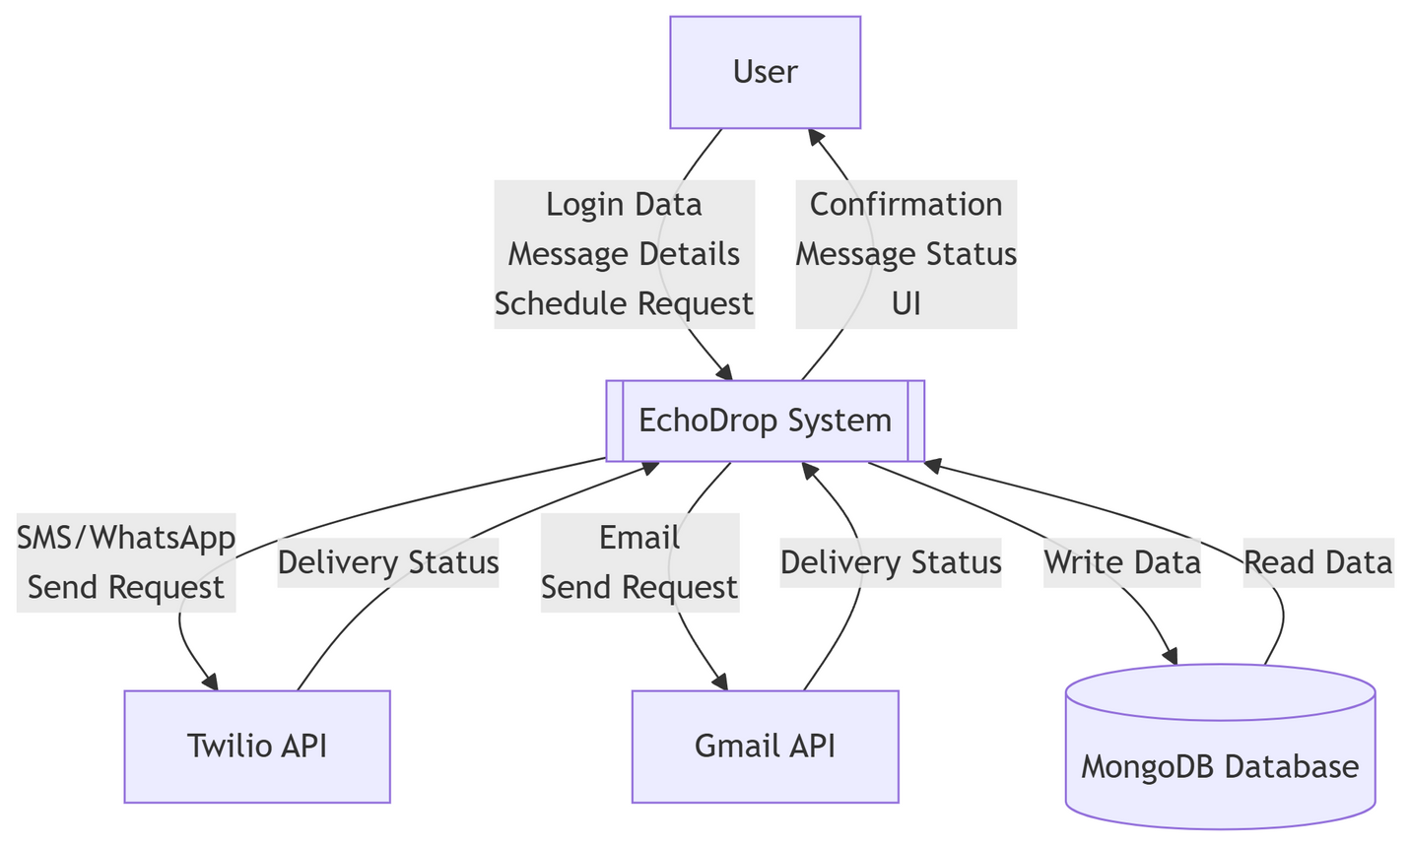

Data Flow Diagram Level 0 (Context Diagram)

Slide 17
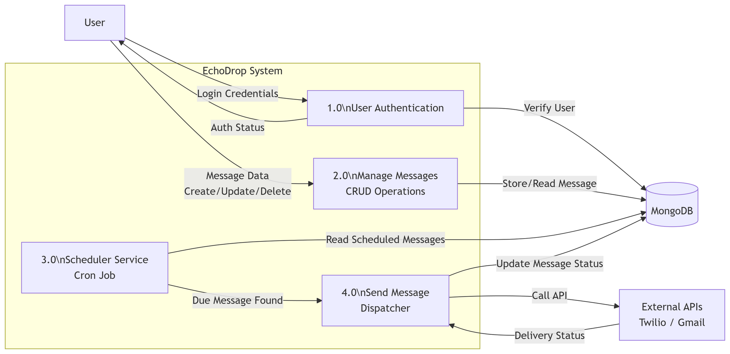
Data Flow Diagram Level 1 (Main Processes)

Slide 18





06
Key Features

Slide 19
🔐 Secure JWT Authentication & Google OAuth 2.0
📅 Intuitive DateTime Scheduling Interface
📊 Real-Time Message Status Tracking (Pending, Processing, Sent, Failed)
✏️ CRUD Operations on Pending Messages
📋 Detailed Delivery Logs & History
⚡ Responsive Angular UI with Modern Design

Slide 20
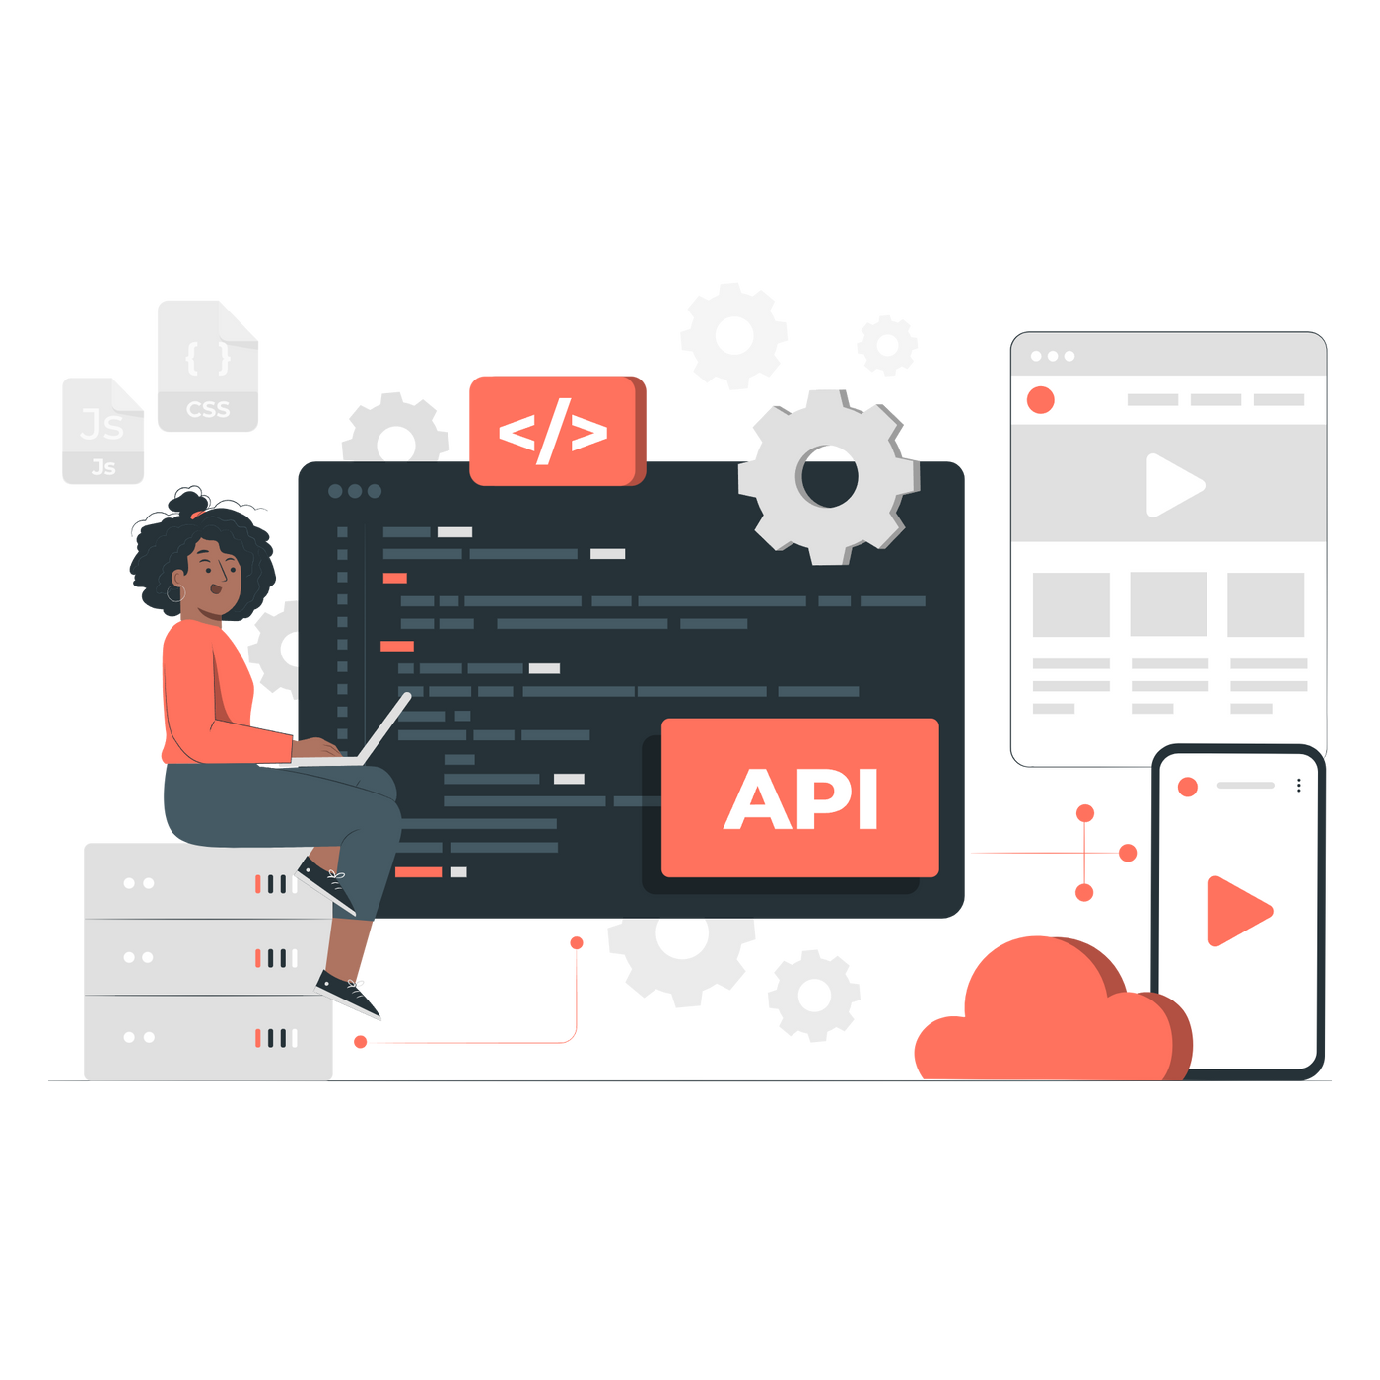
07
Backend Deep Dive

Slide 21


Scheduler Service - The Brain ( scheduler.js )
// Runs every minute
cron.schedule("* * * * *", async () => {
const dueMessages = await ScheduledMessage.find({
status: "pending",
scheduledTime: { $lte: new Date() },
});
dueMessages.forEach(msg => sendMessage(msg));
});
The cron job that fatches and processes all due messages automatically.

Slide 22

08
Frontend Deep Dive

Slide 23
AuthGuard - Route Protection ( auth.guard.ts )
export const AuthGuard: CanActivateFn = (route, state) => {
const token = route.queryParamMap.get('token'); // Handle Google OAuth redirect
if (token) auth.setToken(token);
return auth.isLoggedIn() ? true : router.navigate(['/login']);
};
Seamlessly handles both manual login and OAuth redirects while protecting routes.

Slide 24

09
Database Schema

Slide 25
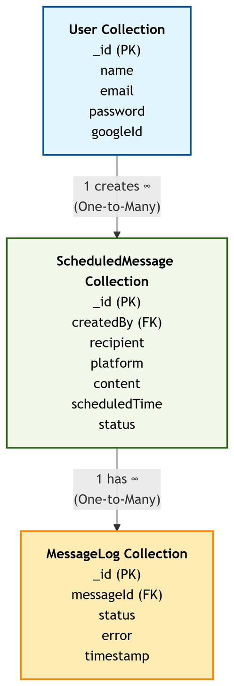

Slide 26

10
Screenshots - User Authentication

Slide 27
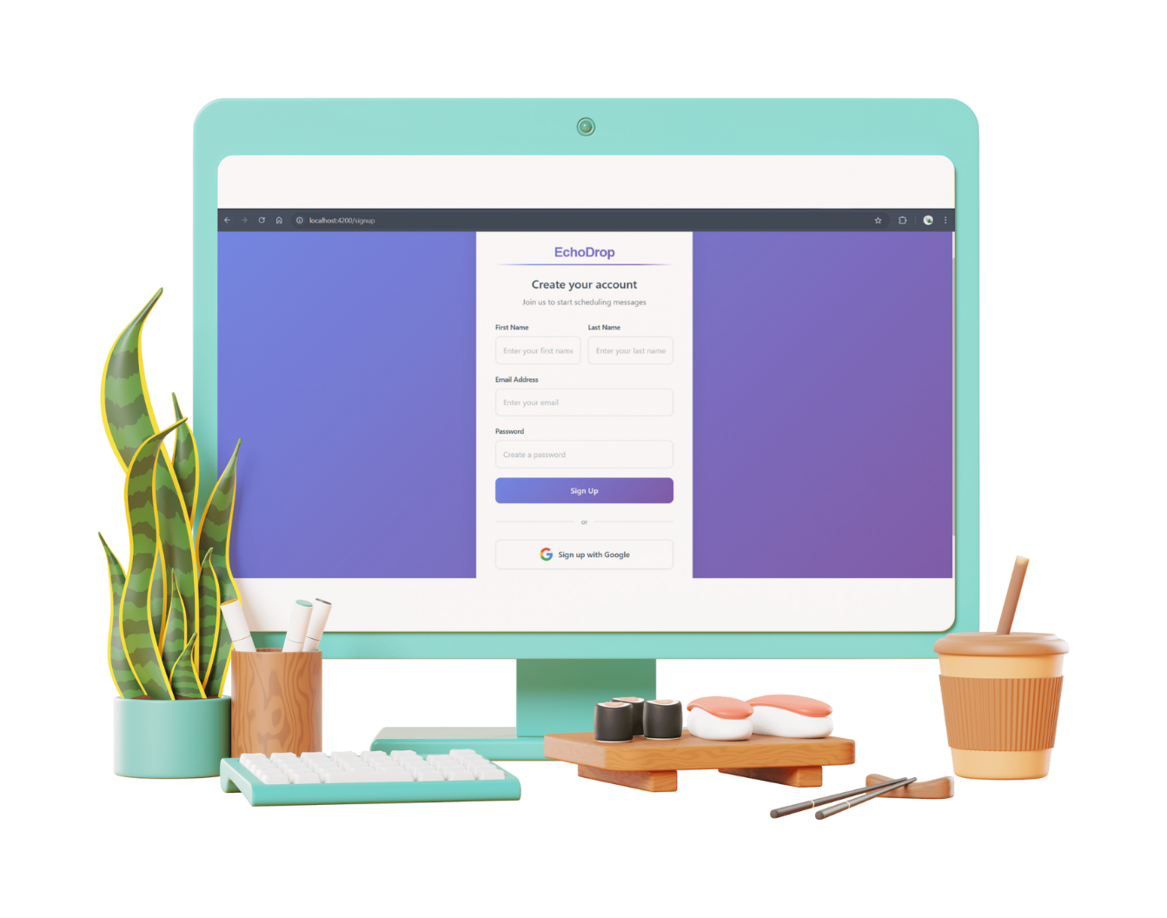
Clean Signup Page with Google OAuth option

Slide 28

Clean Login Page with Google OAuth option

Slide 29
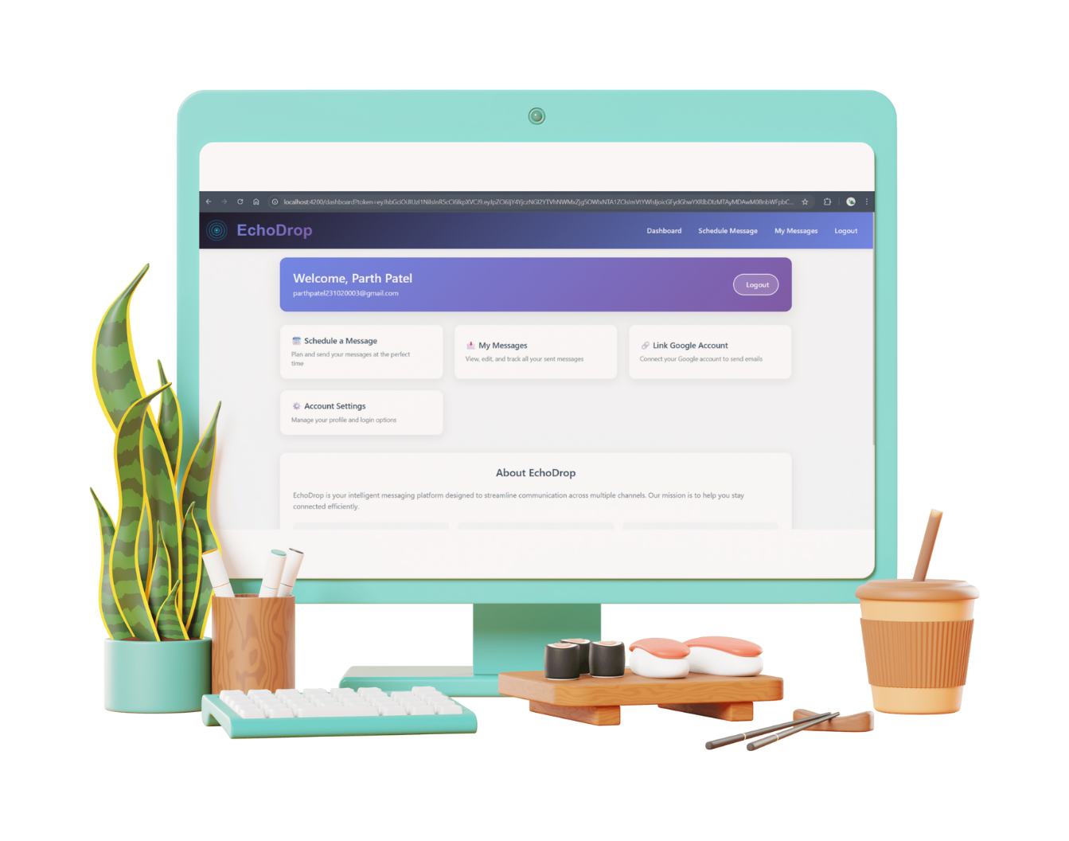
Dashboard Post-Login showing user greeting and access cards

Slide 30

11
Screenshots - Scheduling & Management

Slide 31
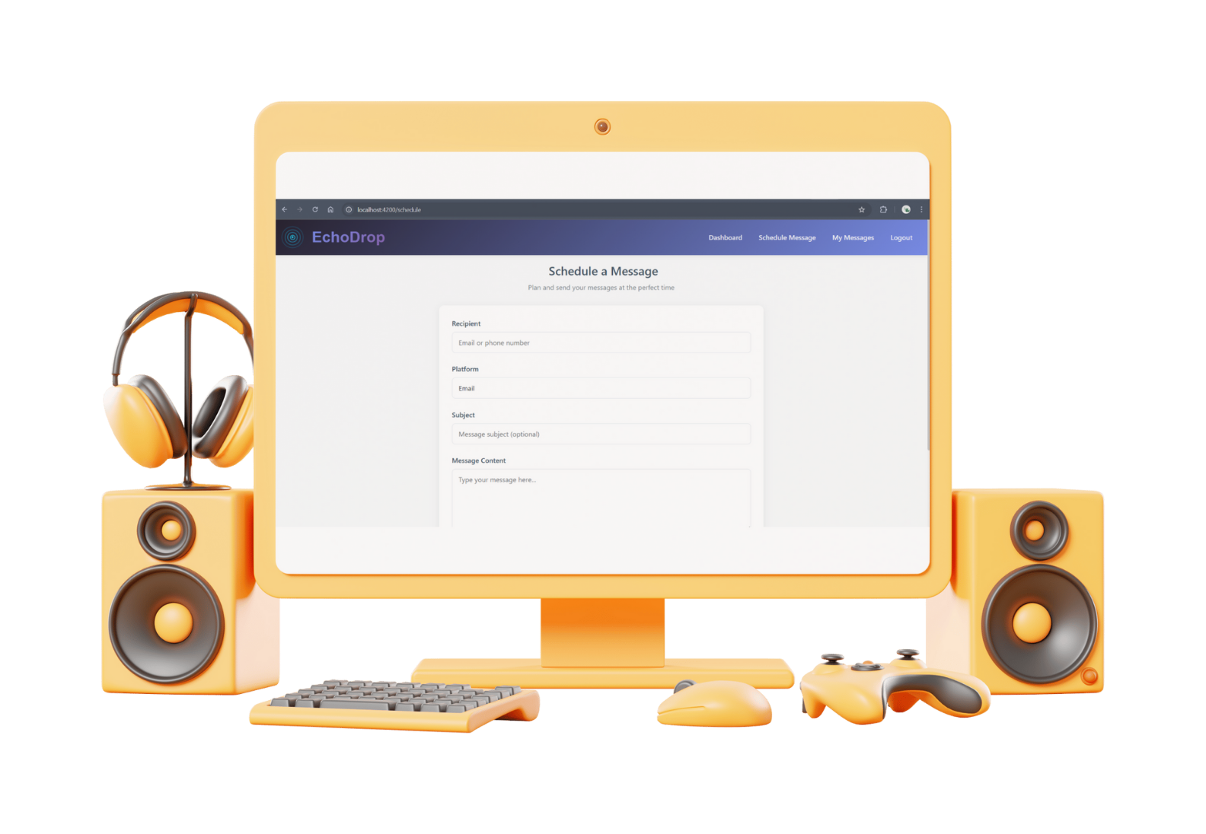
Schedule Form: Platform selector, recipient input, datetime picker

Slide 32
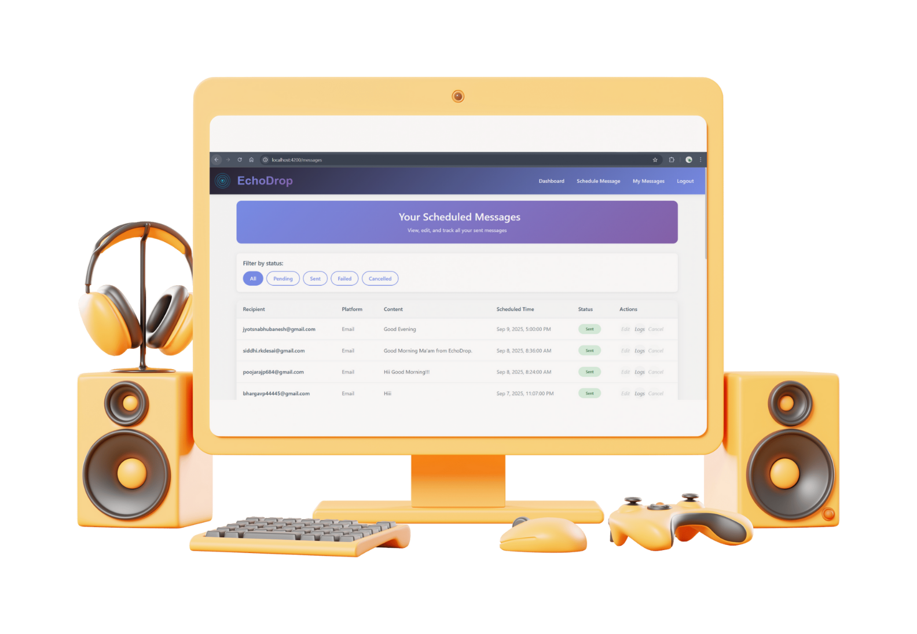
Messages List View: Table with status badges, filter buttons, and action buttons (Edit, Logs, Cancel)

Slide 33

12
Challenges & Solutions

Slide 34
Challenge | Solution
Gmail API Integration | Used OAuth 2.0 with refresh tokens instead of insecure app passwords.
Real-Time Status Updates | Implemented automatic frontend polling every 5 seconds to refresh the message list.
Angular SSR Compatibility | Used isPlatformBrowser() to guard against server-side excution of localStorage code.
Token Handling | AuthGuard captures token from URL after OAuth redirect before navigation.

Slide 35

13
Conclusion & Future Scope

Slide 36
Conclusion:
Successfully developed a fully functional, secure, and scalable scheduled messaging platform.
Mastered full-stack integration with complex third-party APIs.
Future Scope:
Group Messaging: Send to multiple recipients.
Message Templates: Save and reuse common messages.
Advanced Analytics: Charts and graphs for message performance.
Mobile App: React Native or Ionic version.
Current Limitations: Production deployment with full authentication and messaging capabilities.

Slide 37

14
References

Slide 38
References:
Angular Documentation
Node.js & Express.js Guides
Twilio API Docs
Google Gmail API Docs
MongoDB University

Slide 39
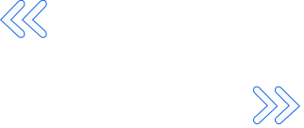

Thank You!

